Slide 1


Pre-Practicum 2: NI ELVIS
(EBN 122 : Electricity and Electronics)
Introduction to:
  National Instruments
  Education Laboratory
  Virtual Instrument Suite
By Dieter Barnard

Slide 2

EBN 122: Practical 2
Agenda
Practicum Guide
Introduction to Virtual Instrumentation (VI)
Identification of the instruments of the NI ELVIS Workstation
Familiarization with NI ELVIS Soft Front Panel (SFP) Instrumentation
Circuit measurements using the Function Generator (FGEN) and Oscilloscope (OSC)
Circuit measurements using the Variable Power Supply (VPS) and Digital Multi Meter (DMM)
NI ELVIS Characterization
Complete the Online assessment exercises

Slide 3

EBN 122: Practical 2
Objectives
The objective of this practicum is to familiarize the student with the following:
  Virtual Instrumentation (VI);
  The NI ELVIS Workstation;
  The NI ELVIS Soft Front Panel (SFP) Instrumentation;
  Circuit measurements using the VI Function Generator and Oscilloscope;
  Circuit measurements using the VI Variable Power Supply and Digital Multi Meter

Slide 4

EBN 122: Practical 2
Background
Circuit measurements using instrumentation for test and measurement is an essential skill in the design and analysis of electrical, electronic and computer circuits.
Virtual Instrumentation implementing PC-based measuring instruments is an effective approach to introduce students to the range of measurements required for the characterization of electrical circuits.
Virtual Instrumentation, such as the NI ELVIS system implemented in the CAEC lab, is also widely used in industry due to the versatility and efficiency it provides in measurement and control applications.

Slide 5

EBN 122: Practical 2
Background
This practicum provides an opportunity to gain some skill in using the NI ELVIS VI measurement system.
These skills will be used in subsequent practicum's in EBN111, in many other modules in Electrical, Electronic and Computer Engineering and in Engineering practice.

Slide 6

EBN 122: Practical 2
Introduction to a VI System
Hardware
  Computer (PC)
  Measurement device (Data Acquisition Card DAQ)
  Signal Conditioning unit (NI ELVIS workstation)
  Circuit construction board (Prototyping board)
Software
  Programming Language (LabVIEW)
  Soft Front Panel (SFP) control of Virtual Instruments

Slide 7


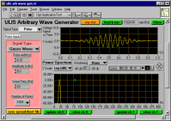
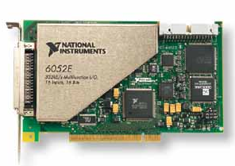
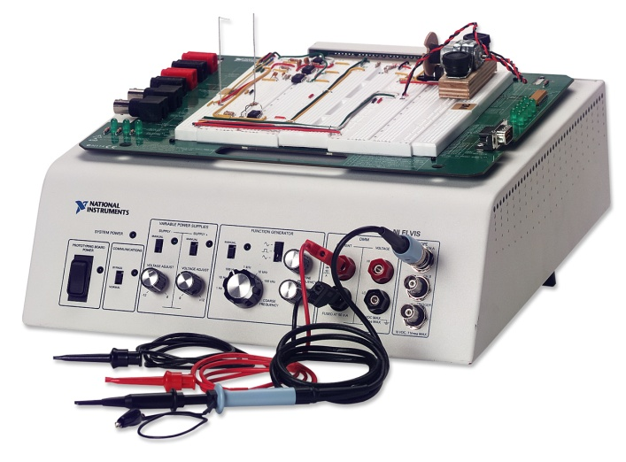
EBN 122: Practical 2
Components of a VI System
Software
Cable
PC
Data Acquisition Board (DAQ)
NI ELVIS Workstation and Protoboard

Slide 8

EBN 122: Practical 2
NI ELVIS workstation
SYSTEM POWER Switch
  The system power switch is located on the right rear of the NI ELVIS workstation.
  The system power switch must be on before you launch the NI ELVIS Soft Front Panel program from the PC desktop.

Slide 9
EBN 122: Practical 2
NI ELVIS workstation
PROTOTYPING BOARD
POWER
  The switch for applying power to the prototyping board is located on front panel of the NI ELVIS workstation.
  The prototyping board power must be on for the DC Power Supplies and Variable Power Supplies to operate.

Slide 10

EBN 122: Practical 2
NI ELVIS workstation
Power Supplies
  5 VDC (2 A)
  ± 15 VDC (500 mA)
  Variable power supply (VPS) (±12 V, 150 mA)
The Variable Power Supplies are only adjustable from the control panel of the workstation in MANUAL mode. The MANUAL switch must be OFF if you want to adjust the Variable Power Supplies using the Soft Front Panel Controls on the PC.

Slide 11
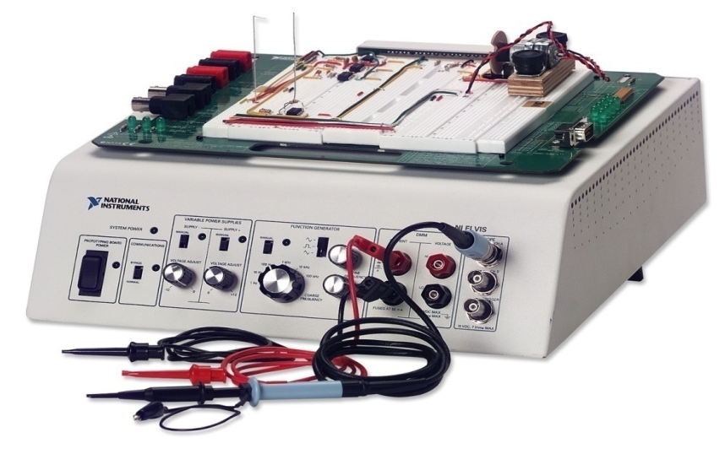
EBN 122: Practical 2
NI ELVIS workstation
  Analog Signal Sources
  Function Generator (FGEN)
    Waveforms: Sine, square, triangle
    Frequency range: 5 Hz to 250 kHz
    Output amplitude: 0 to ±2.5 V
    Offset adjust: -5 V to +5 V
    Drive current: 25 mA
    Modulation: FM, AM
Note: The Function Generator is only adjustable from the
control panel of the workstation in MANUAL mode.
The MANUAL switch must be OFF if you want to adjust the Function Generator using the Soft Front Panel Controls on the PC.

Slide 12

EBN 122: Practical 2
NI ELVIS workstation
Analog inputs
  Digital Multi Meter (DMM)
  Oscilloscope (OSC)

Slide 13
EBN 122: Practical 2
NI ELVIS workstation
Prototyping board
  Circuit construction

Slide 14
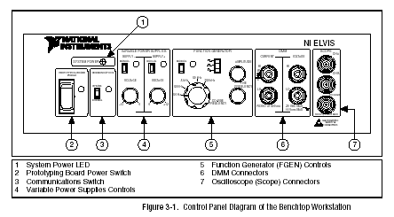
EBN 122: Practical 2
NI ELVIS workstation

Slide 15
EBN 122: Practical 2
NI ELVIS: Pre-Prac Questions
Which instruments are adjustable from the front panel of the NI ELVIS workstation ?
What is the maximum voltage available from the NI ELVIS variable power supply?
What is the maximum output amplitude of the NI ELVIS function generator?
What is the maximum current that the NI ELVIS function generator can deliver?

Slide 16
EBN 122: Practical 2
Conclusion – Be Prepared
Contact details for Questions or Feedback
  Email: dieter.barnard@up.ac.za
    NB: For all emails use the subject “[EBN122] …”
  Office no.: Eng 1, 13-27
During practical
  There will be Demis to assist you during the whole duration of the practical
  Ask questions and remember you can also refer to the practical guide or materials available on the module website

